Slide 1
Sri Lanka Institute of Information Technology.

Slide 2
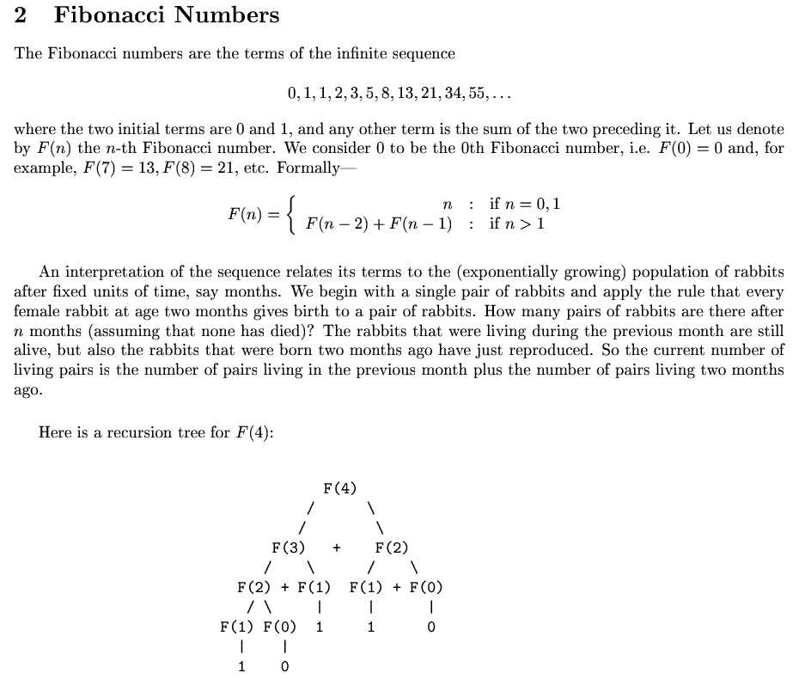
Sri Lanka Institute of Information Technology.

Slide 3
Exercise 01.
Write a recursive function to calculate fibonacci value for given input n.
Write a iterative function to calculate fibonacci value for given input n.
Sri Lanka Institute of Information Technology.

Slide 4
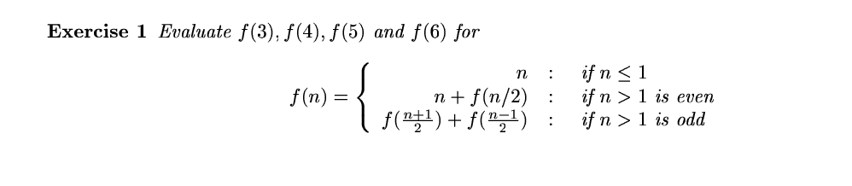
Exercise 02.
Calculate the f(3),f(4),f(5) and f(6) manually
Sri Lanka Institute of Information Technology.

Slide 5
Exercise 03.
Write a recursive function to calculate f(n) for following recursive function
Sri Lanka Institute of Information Technology.

Slide 6
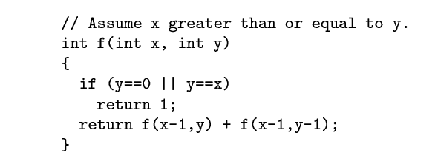
Exercise 04.
What is returned by f(5,3) ?
Sri Lanka Institute of Information Technology.

Slide 7
Exercise 05
Write a recursive function that computes the sum of all numbers from 1 to n, where n is given as parameter.
Sri Lanka Institute of Information Technology.

